Slide 1
3D Face Reconstruction using Photometric Stereo
Guru Subramani
Ezhilsivam Shanmugam

Slide 2
Introduction To Photometric Stereo
Estimate the surface normals of the object by observing it under different lighting conditions.
Given enough light sources from different angles, the depth information can be recovered.
Notes:
Images taken in different lighting conditions are used to solve the depth information

Slide 3
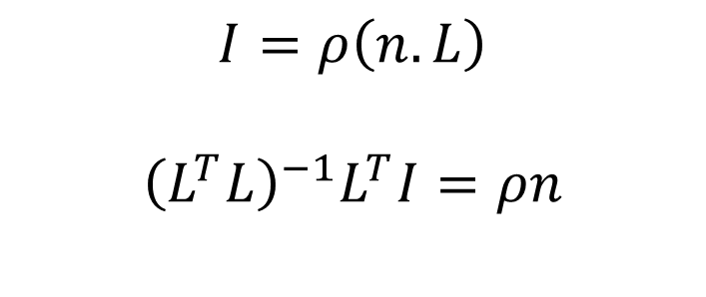
Applying Photometric Stereo to Human face
Human face /skin follows Lambertian reflectance property.
Known Intensities
$$I=ρ\left(n.L\right)$$
$${\left(L^{T}L\right)}^{−1}L^{T}I=ρn$$
Light Source Direction
Normals (to be computed)

Slide 4
Previous Work - 3D Face Reconstruction
Shape From Shading.
Using an Example object with same reflectance properties to find the light direction. (and applying Photometric Stereo)
Using a Single Reference 3D Face Shape model and shading information. (uses prior knowledge about face features)
With 3D laser scanned training set of face models.
Using the symmetric property of the face.

Slide 5

Computing Light Direction from the Eye

Slide 6
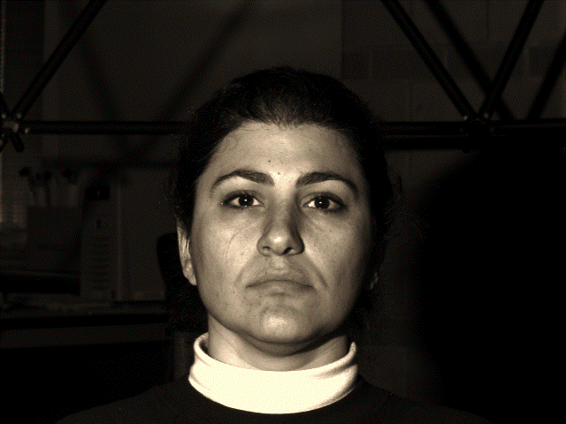
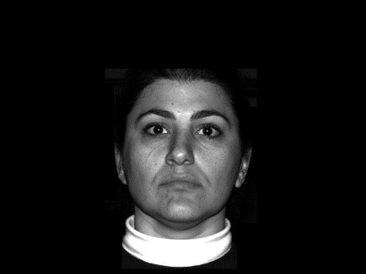
Computing Light Direction from the Eye
Extract Eye(s)
Input Images
Background Subtracted
Apply color Texture
Photometric Stereo
Compute Light Directions

Slide 7
Computing Light Directions - Idea
Use the Eyes’ Specular Highlight (bright spot)
For specular reflections angle of incidence is equal to the angle of reflection
i = r
What do we need:
Direction of light towards the eye from the source
Direction of reflected light from the eye towards the camera
Geometry of the eye to compute the normal
i
r
N

Slide 8
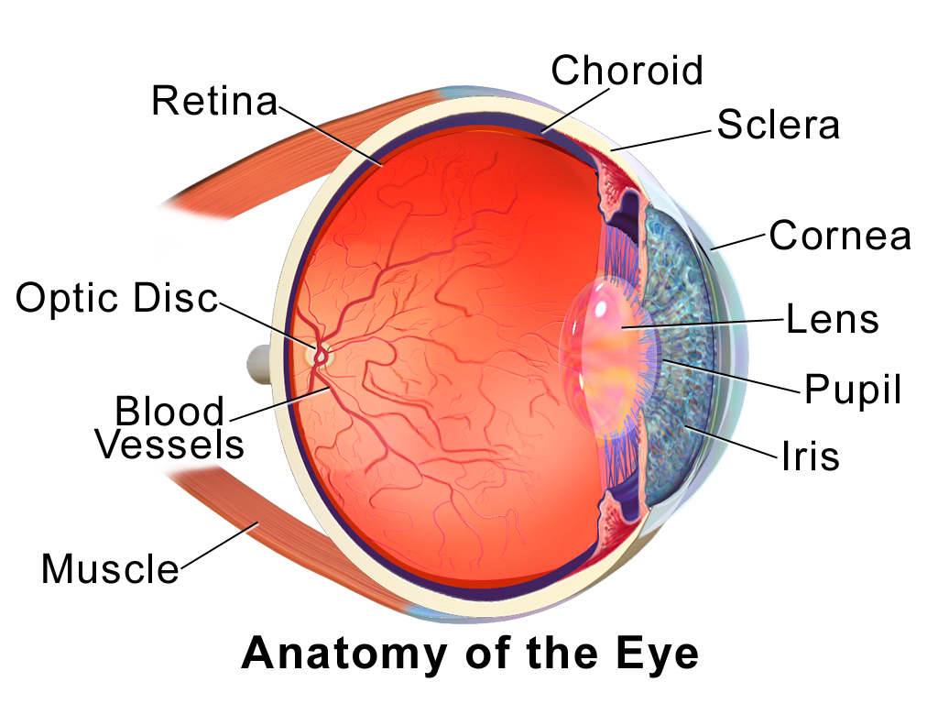
Geometry of the Human Eye
We need the cornea’s radius and the Iris radius
Anatomically for adults:
Cornea sphere radius = 8 mm
Iris circle radius = 12 mm
These values barely vary in adults
With this information the Normal at a specific point on the eye can be computed
Courtesy: Wikipedia

Slide 9
Light Locations/Camera Locations
What we know:
Normal vector at light incident location
What we don’t know:
Camera position
Light source position
Assume reflected ray is normal to face direction
Compute incident light directions
i
r
N

Slide 10
Compute Light Directions
Rotation Axis
Method
Find Normal vector
Assume v is directed in the z direction [0 0 1]
Find angle of reflection ‘r’
Find rotation axis: N x v
Find magnitude of rotation:
Sin⁻¹(N x v/|N ||v|)
Rotate v by twice this angle about axis
i
r
v
N

Slide 11
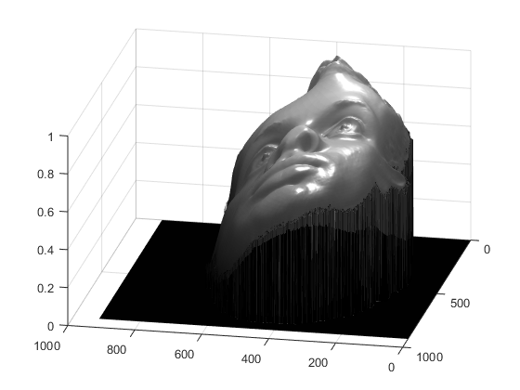
Results
Issues:
The 3d reconstruction is tilted
Might be an artifact of assuming the camera direction.
Corrective Measure:
It would be safe to assume that the mean normal direction of the face is directed towards the Z axis
From the computed normals; find the mean normal direction.
The camera should be on the other side of this normal w.r.t the initial assumed normal
Move the camera to a new location: v’ = -an’ where a is a positive scalar
Keep doing this (4 times good enough)
n’
n
v’
v
Newly Assumed Camera
Location
Assumed Camera Location

Slide 12
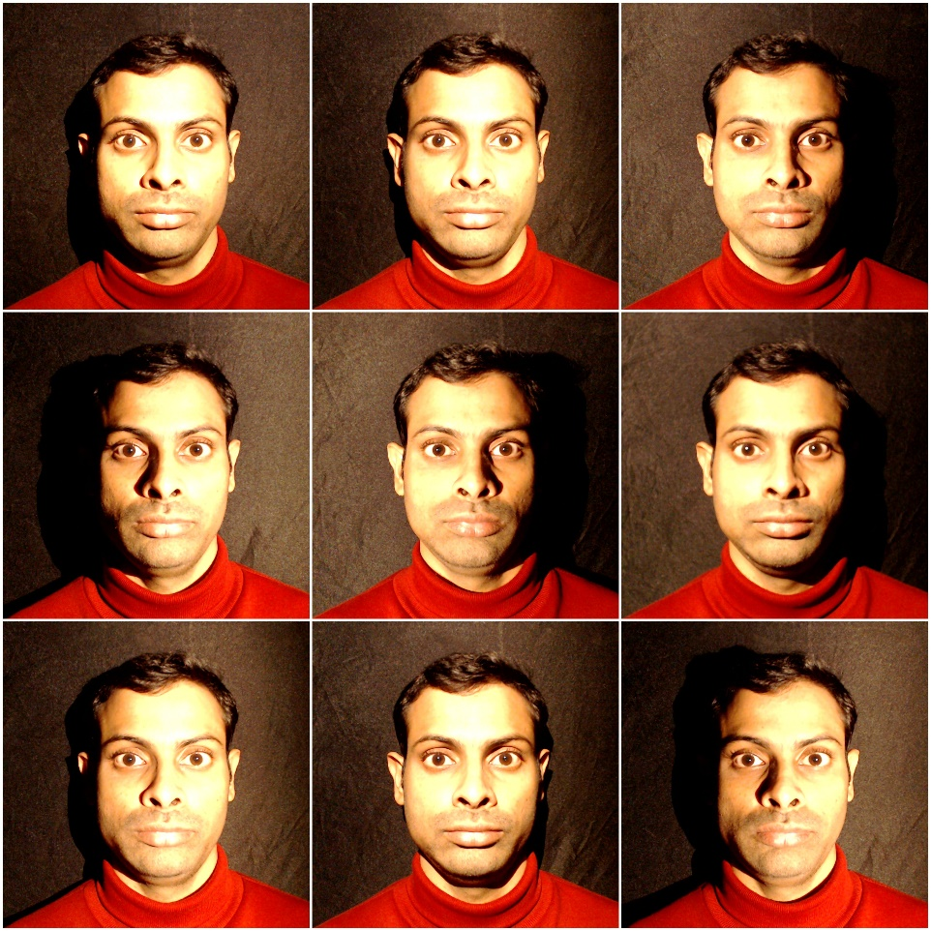
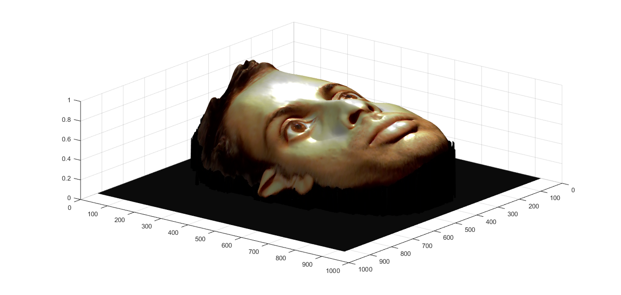
Better Results (With our own dataset)
The camera position is computed
The 3d face reconstruction has improved!

Slide 13
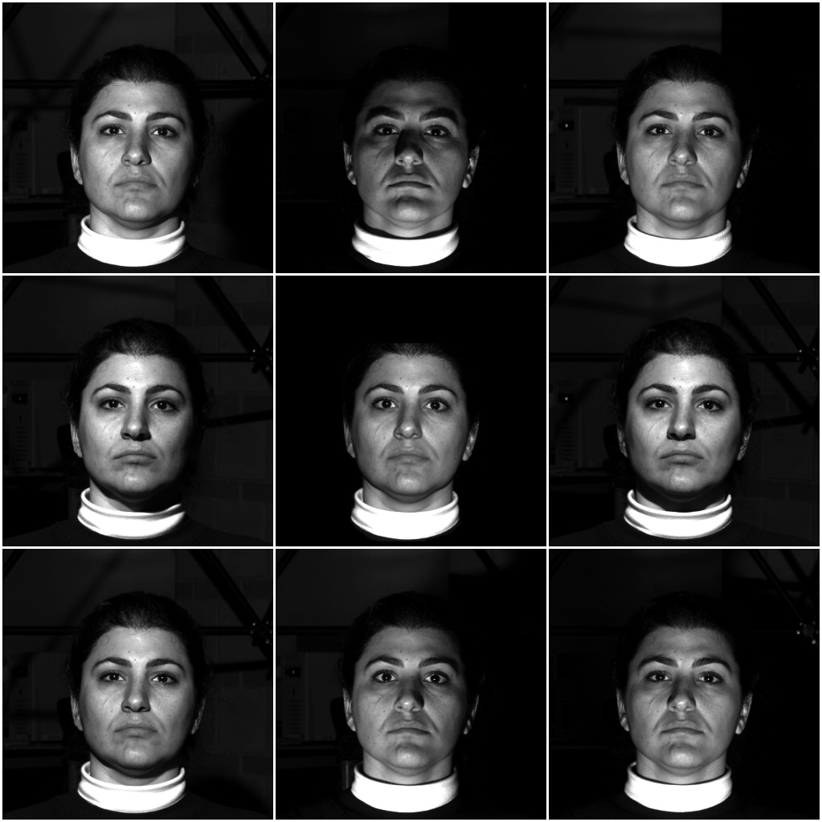
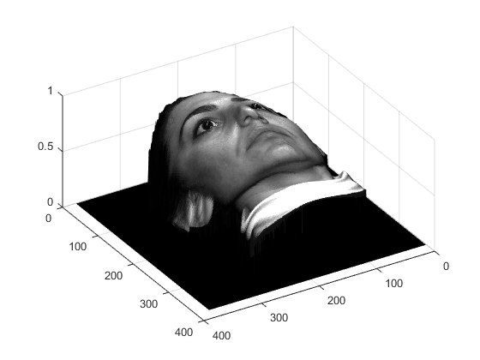
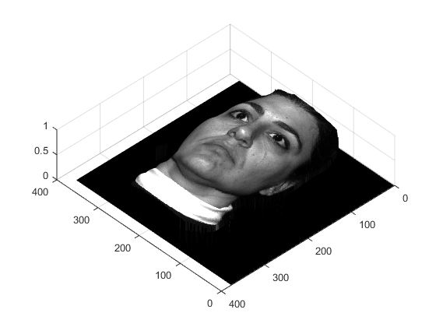
More Results (with diff datasets)
Dataset courtesy of Yale Database B

Slide 14
Future Work
Formalize the error correction method for camera direction
Automate Eye extraction using some Machine learning algorithm
Evaluation Methods

Slide 15
References
3D Face Reconstruction from a Single Image using a Single Reference Face Shape [Ira Kemelmacher-Shlizerman, Ronen Basri]
Statistical symmetric shape from shading for 3d structure recovery of faces. [R. Dovgard and R. Basri.]
Recovering facial shape and albedo using a statistical model of surface normal direction [W.A.P Smith and E.R. Hancock]
B.K.P. Horn and M.J. Brooks, editors. Shape from Shading. MIT Press: Cambridge, MA, 1989.
Yale Database B

Slide 16

Questions

